Slide 1
INDIAN PREMIER ANALYSIS
Unrestricted

Slide 2
Analyzing Data
As part of this project the data is being analyzed from different point so that it would help the team management to select the rite players for their team.
The various are that re focused for analysis include
Batsmen Aggregate over seasons
Bowlers Aggregate over seasons
Team wins in Home vs Away
Top Batsmen over seasons
Top Bowlers over seasons
Impact of toss on the match outcome

Slide 3
Data Source
The data source for this project have been taken from Kaggle. The main source of data are the two csv files matches and deliveries respectively. The matches file contains the entire information about the matches played by every team over a different season. On the other hand, the delivery data sheet contains the complete information of the bowlers from all team with stats containing the number of overs they bowled, with number of runs they gave with number of wickets they picked up and finally there their respective economical rates from bowling end.

Slide 4
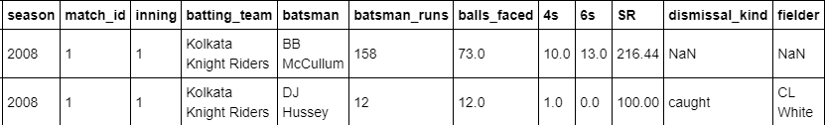
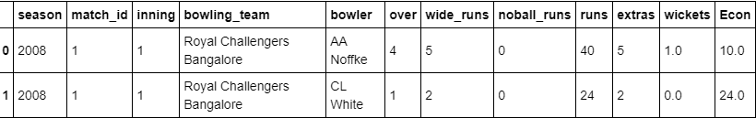
Batsmen & Bowlers Aggregate
Batsmen
Bowler

Slide 5
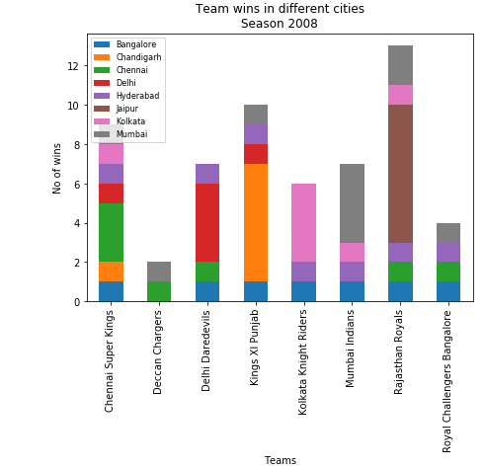
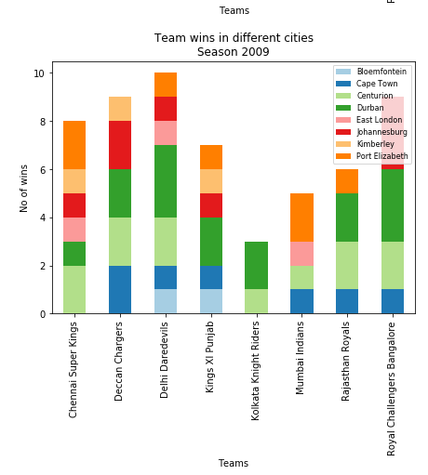
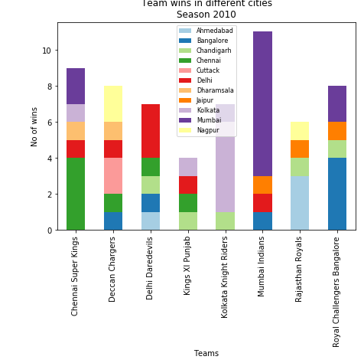
Team Wins Home Vs Away
2009
2010
2008

Slide 6
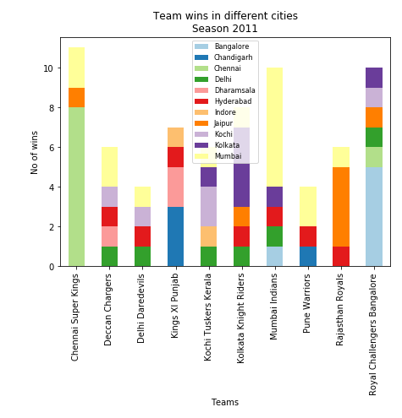
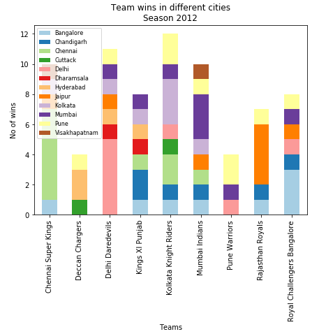
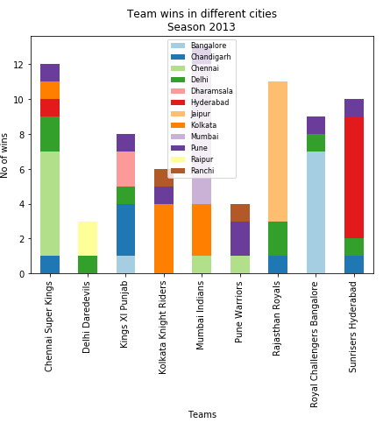
Team Wins Home Vs Away
2011
2012
2013

Slide 7
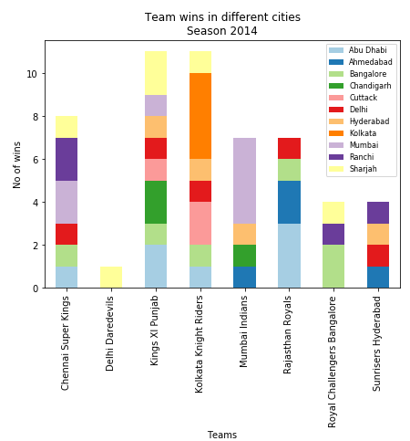
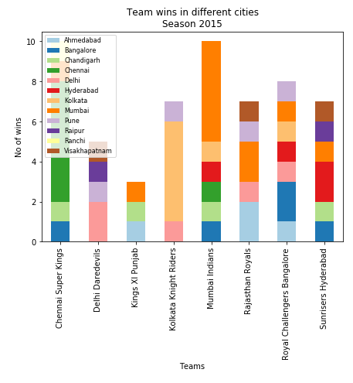
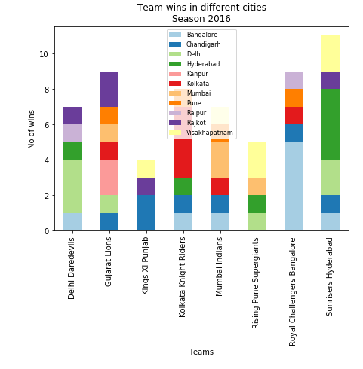
Team Wins Home Vs Away
2014
2015
2016

Slide 8
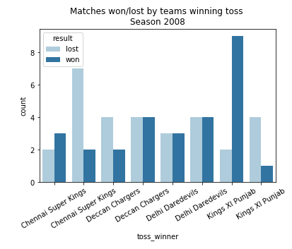
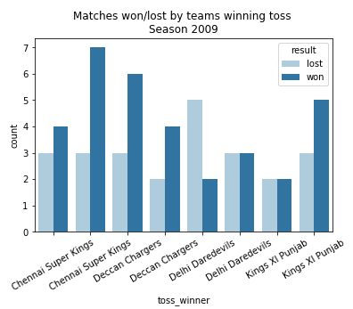
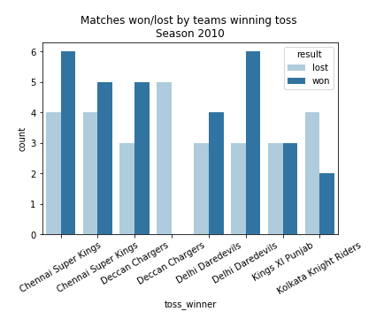
Impact of toss on the match outcome
2008
2010
2009

Slide 9
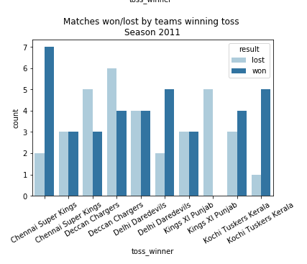
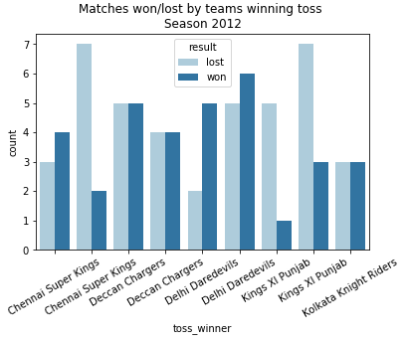
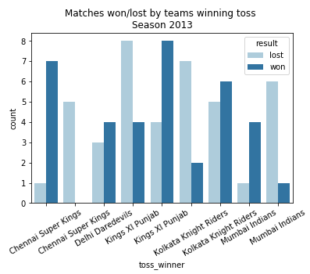
Impact of toss on the match outcome
2011
2013
2012

Slide 10
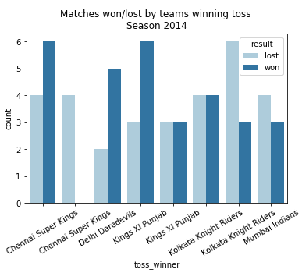
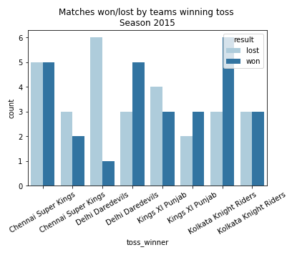
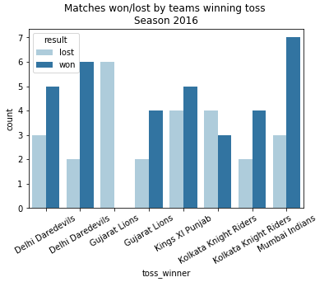
Impact of toss on the match outcome
2014
2016
2015

Slide 11
Result:
After doing the above analysis we can say that when team management gets the information about these information’s presented in above section, it would help them to pick the rite team with combination of good batsmen and bowlers. It would also help the team to know their performance when played under home condition and when played under non-home conditions.
Discussion:
For any more information on the ipl I would suggest visiting the https://www.iplt20.com/ where users can get much more information in case if they need to analyses any more things
Conclusion:
After collecting information about the IPL teams, bowlers, batsmen, team performance when played under home condition and when played under non-home conditions and analyzing thing and finally present them in form of charts I would like to conclude my project.

Slide 12
THANK YOU

